Slide 1
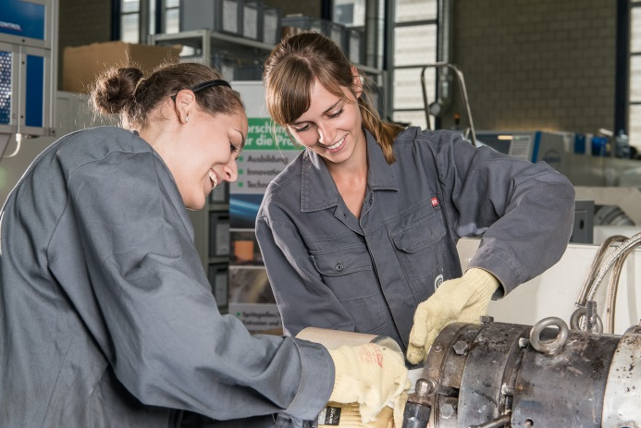

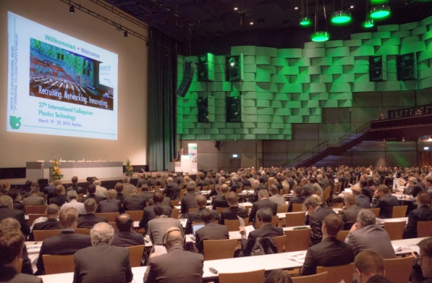
Analysis of transfer learning to transfer process knowledge when processing different materials
Weibo Zhao, B. Sc.
Supervisor: Yannik Lockner, M. Sc.
13.10.2020
Notes:
$用左手拿笔$
站得稳一点，不要走
Good afternoon everyone, welcome to my master thesis presentation. My name is Weibo Zhao. I want to thank my supervisor Yannik Lockner for his help and guidance. The topic of my thesis is analysis of transfer learning to transfer process knowledge when processing different materials.

Slide 2
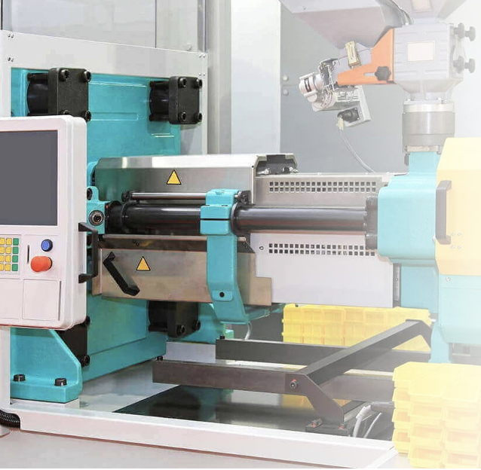
Outline
Motivation of applying transfer learning
Dataset description and feature ranking
Construction of DNN-ETL model
Transfer performance analysis
Application scenario of DNN-ETL
Conclusion and outlook
[URL00]
1
Notes:
The presentation is divided into six parts.

Slide 3
Outline
Motivation of applying transfer learning
Dataset description and feature ranking
Construction of DNN-ETL model
Transfer performance analysis
Application scenario of DNN-ETL
Conclusion and outlook
[URL00]
1
Notes:
The first part is the motivation of applying transfer learning

Slide 4
Motivation of applying transfer learning in injection molding Conventional deep learning approach
Objective
To analyse the possibility to transfer knowledge between processes where different materials are being utilized.
2
Notes:
The objective of this thesis is to analyse the possibility to transfer knowledge between processes where different materials are being utilized. As for a conventional deep learning approach, we build a deep neural network, which is abbreviated as DNN. The input of this model are machine settings and material properties. And the output is the product quality values. We hope improve the prediction performance as much as possible. However, this approach faces two challenges: On the one hand, it requires large ﻿amount of process data to train the models, but in real-world applications, collecting injection molding data is a costly and time-consuming process. On the other hand, there is high training effort of the fitting models in the changes of production process. For example, when we change the product material, the DNN needs to rebuild from scratch. These challenges can be addressed by fostering transfer learning.

Slide 5
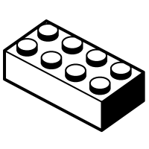
Motivation of applying transfer learning in injection molding Conventional deep learning approach
Objective
To analyse the possibility to transfer knowledge between processes where different materials are being utilized.
Machine
settings
Material properties
Product quality
Deep Neural Network(DNN)
2
Notes:
The objective of this thesis is to analyse the possibility to transfer knowledge between processes where different materials are being utilized. As for a conventional deep learning approach, we build a deep neural network, which is abbreviated as DNN. The input of this model are machine settings and material properties. And the output is the product quality values. We hope improve the prediction performance as much as possible. However, this approach faces two challenges: On the one hand, it requires large ﻿amount of process data to train the models, but in real-world applications, collecting injection molding data is a costly and time-consuming process. On the other hand, there is high training effort of the fitting models in the changes of production process. For example, when we change the product material, the DNN needs to rebuild from scratch. These challenges can be addressed by fostering transfer learning.

Slide 6
Motivation of applying transfer learning in injection molding Conventional deep learning approach
Objective
To analyse the possibility to transfer knowledge between processes where different materials are being utilized.
Machine
settings
Material properties
Product quality
Challenges
Deep Neural Network(DNN)
Require large ﻿amount of process data
High training effort of the fitting models in the changes of production process
2
Notes:
The objective of this thesis is to analyse the possibility to transfer knowledge between processes where different materials are being utilized. As for a conventional deep learning approach, we build a deep neural network, which is abbreviated as DNN. The input of this model are machine settings and material properties. And the output is the product quality values. We hope improve the prediction performance as much as possible. However, this approach faces two challenges: On the one hand, it requires large ﻿amount of process data to train the models, but in real-world applications, collecting injection molding data is a costly and time-consuming process. On the other hand, there is high training effort of the fitting models in the changes of production process. For example, when we change the product material, the DNN needs to rebuild from scratch. These challenges can be addressed by fostering transfer learning.

Slide 7
Conducting experiments with a new material
Source dataset
Large process databank of multiple materials
Target dataset
Several data points of a new material
3

Slide 8
Conducting experiments with a new material
Source dataset
Large process databank of multiple materials
Related but different
Same feature space
Different distribution
Target dataset
Several data points of a new material
3

Slide 9
Comparison of conventional DNN and DNN with transfer learning
Conventional DNN
DNN-TL
Training is isolated
Knowledge is not retained or accumulated
Training of a new task relies on the previous learned task
Faster training, accurate, less training data
Source dataset
Learning system
source task
Source dataset
Learning system
source task
Knowledge
Target dataset
Learning system
target task
Target dataset
Learning system
target task
[OBL14]
4

Slide 10
Outline
Motivation of applying transfer learning
Dataset description and feature ranking
Construction of DNN-ETL model
Transfer performance analysis
Application scenario of DNN-ETL
Conclusion and outlook
[URL00]
5
Notes:
The second part is dataset description and feature ranking.

Slide 11



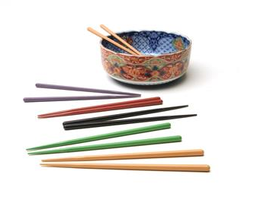
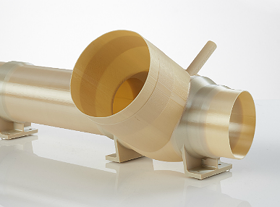
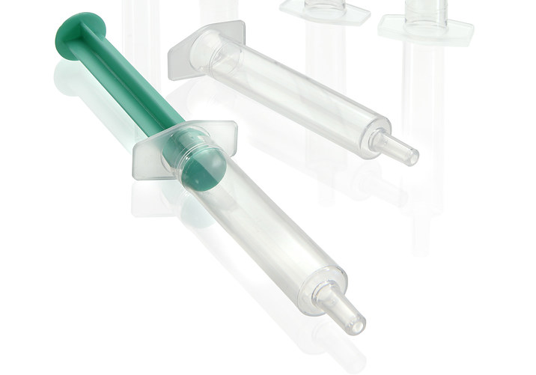
Material series, polymer classes, manufacturers and amount
APEC
PLEXIGLAS
01
02
Polycarbonate
Company: Covestro
Amount: 13
Polymethylmethacrylat
Company: Evonik
Amount: 10
不要说数量
01
02
ULTRAMID
VALOX
03
04
Polyamid
Company: BASF
Amount: 9
Polybutylenterephthalat
Company: Sabic
Amount: 4
03
04
ULTEM
SABIC PP
05
06
Polyetherimid
Company: Sabic
Amount: 6
Polypropylene
Company: Sabic
Amount: 17
05
06
[URL01]
6
Notes:
materials belong to different material series and also produced by different manufacturers.
APEC: Heat resistance in the secondary production process of smart devices.

Slide 12
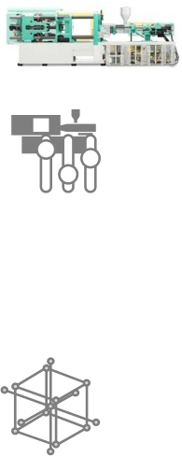

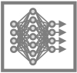
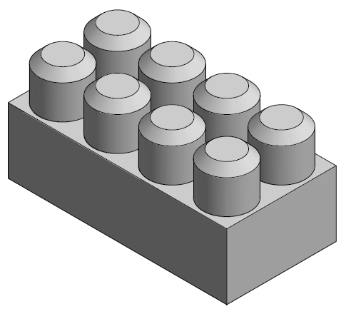
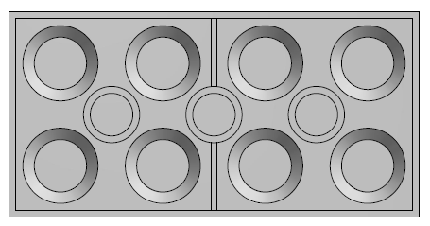

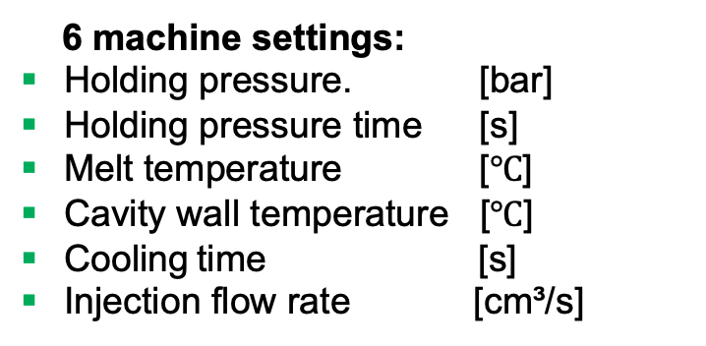
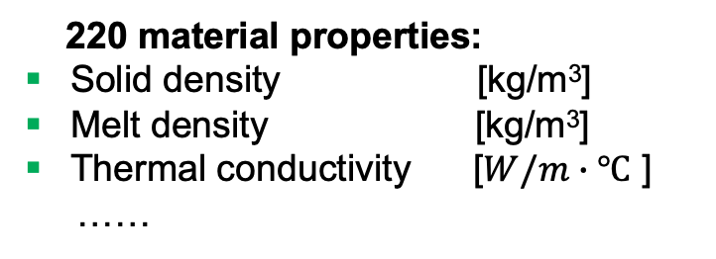
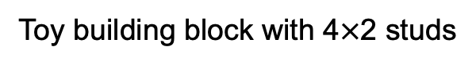
Input and output variables of DNN model based on injection moulding simulation
5 quality values:
▪ Part weight [g]
▪ Length [mm]
▪ Height [mm]
▪ Width [mm]
▪ Angle [°]
60 materials, 77 experiments for each one
6 machine settings:
Holding pressure. [bar]
Holding pressure time [s]
Melt temperature [$℃$]
Cavity wall temperature [$℃$]
Cooling time [s]
Injection flow rate [cm³/s]
Height
W°
220 material properties:
▪ Solid density [kg/m³]
▪ Melt density [kg/m³]
▪ Thermal conductivity [$W/m∙℃$ ]
……
Length
Angle
Width
Toy building block with 4$×$2 studs
[Hei17]
7
Notes:
We simulate the injection molding process of a toy building block with 4x2 studs in a software CADMOULD 10. We apply the simulation for 60 materials. 77 experiments of different process conditions are used for each of the material.There are 6 machine settings feature and 44 material properties features as the input of DNN model. The output are 5 quality values.
The total dataset contains two kinds of features:
Machine setting features: For each part, six machine setting parameters of the process are varied, namely holding pressure level, holding pressure time, mould temperature, cooling time, melt temperature, and volume ﬂow in a central composite experimental design with 77 test points.
Material property features: For totally 60 different materials, there are 138 physical, chemical, electronic, thermodynamic, and mechanical properties for each material. The dataset is exported from CADMould database.
The total dataset also includes five product quality values to measure the product quality.

Slide 13
Input and output variables of DNN model based on injection moulding simulation
5 quality values:
▪ Part weight [g]
▪ Length [mm]
▪ Height [mm]
▪ Width [mm]
▪ Angle [°]
60 materials, 77 experiments for each one
6 machine settings:
Holding pressure. [bar]
Holding pressure time [s]
Melt temperature [$℃$]
Cavity wall temperature [$℃$]
Cooling time [s]
Injection flow rate [cm³/s]
Height
W°
220 material properties:
▪ Solid density [kg/m³]
▪ Melt density [kg/m³]
▪ Thermal conductivity [$W/m∙℃$ ]
……
Length
Angle
Width
Toy building block with 4$×$2 studs
Some features are not related
[Hei17]
7
Notes:
We simulate the injection molding process of a toy building block with 4x2 studs in a software CADMOULD 10. We apply the simulation for 60 materials. 77 experiments of different process conditions are used for each of the material.There are 6 machine settings feature and 44 material properties features as the input of DNN model. The output are 5 quality values.
The total dataset contains two kinds of features:
Machine setting features: For each part, six machine setting parameters of the process are varied, namely holding pressure level, holding pressure time, mould temperature, cooling time, melt temperature, and volume ﬂow in a central composite experimental design with 77 test points.
Material property features: For totally 60 different materials, there are 138 physical, chemical, electronic, thermodynamic, and mechanical properties for each material. The dataset is exported from CADMould database.
The total dataset also includes five product quality values to measure the product quality.

Slide 14
Input and output variables of DNN model based on injection moulding simulation
5 quality values:
▪ Part weight [g]
▪ Length [mm]
▪ Height [mm]
▪ Width [mm]
▪ Angle [°]
60 materials, 77 experiments for each one
6 machine settings:
Holding pressure. [bar]
Holding pressure time [s]
Melt temperature [$℃$]
Cavity wall temperature [$℃$]
Cooling time [s]
Injection flow rate [cm³/s]
Height
W°
220 material properties:
▪ Solid density [kg/m³]
▪ Melt density [kg/m³]
▪ Thermal conductivity [$W/m∙℃$ ]
……
Length
Angle
Width
Toy building block with 4$×$2 studs
Some features are not related
Apply feature ranking method
[Hei17]
7
Notes:
We simulate the injection molding process of a toy building block with 4x2 studs in a software CADMOULD 10. We apply the simulation for 60 materials. 77 experiments of different process conditions are used for each of the material.There are 6 machine settings feature and 44 material properties features as the input of DNN model. The output are 5 quality values.
The total dataset contains two kinds of features:
Machine setting features: For each part, six machine setting parameters of the process are varied, namely holding pressure level, holding pressure time, mould temperature, cooling time, melt temperature, and volume ﬂow in a central composite experimental design with 77 test points.
Material property features: For totally 60 different materials, there are 138 physical, chemical, electronic, thermodynamic, and mechanical properties for each material. The dataset is exported from CADMould database.
The total dataset also includes five product quality values to measure the product quality.

Slide 15
Feature importance score ranking for prediction of part weight
Features [-]
8
Notes:
Table 7.5 ranks the five features with the highest mean feature importance score of six feature ranking algorithms. Due to the space of the thesis, the rest features refer to the appendix.
For the overview of the whole features, Figure 7.4 illustrates the mean feature importance of each feature. The question now is to explain why some features are more important.

Slide 16
Feature importance score ranking for prediction of part weight
Delete the features with score lower than 10⁻⁵
44 material properties and 6 machine settings left
20 features are shown in this figure due to space
Features [-]
8
Notes:
Table 7.5 ranks the five features with the highest mean feature importance score of six feature ranking algorithms. Due to the space of the thesis, the rest features refer to the appendix.
For the overview of the whole features, Figure 7.4 illustrates the mean feature importance of each feature. The question now is to explain why some features are more important.

Slide 17
Feature importance score ranking for prediction of part weight
5 features with highest feature importance
Features [-]
8
Notes:
Table 7.5 ranks the five features with the highest mean feature importance score of six feature ranking algorithms. Due to the space of the thesis, the rest features refer to the appendix.
For the overview of the whole features, Figure 7.4 illustrates the mean feature importance of each feature. The question now is to explain why some features are more important.

Slide 18







Analysis of 5 important influence factors
No flow temperature
Material stops flowing below certain temp.
Defining the amount of entering material
Solid density
Ejection temperature
Related to part weight
Influence shrinkage
Product quality
Holding pressure
Thermal conductivity
Packing molecules together
in an orderly fashion
Shrinkage compensation
Temperature distribution
Warpage of the mould
9
Notes:
Product quality like part weight in the injection moulding process can be attributed to a wide variety of possible causes from material properties and machine setting parameters.
Holding pressure is used to finish filling the mould by packing the molecules together in an orderly fashion. After the mold cavity is filled, holding pressure is applied to compensate for shrinkage caused by cooling.
No flow temperature assumes that the polymer material stops flowing under processing condition below certain temperature. It defines the amount of material that enters into the cavity.
Ejection temperature is the temperature at which molded parts are ejected from the injection molding machine.
Thermal conductivity, which describes the heat conducting ability of the interface between a polymer and cavity wall, significantly influences the temperature distribution of a polymer and mould during injection moulding and thus affects the process and quality of plastic products.

Slide 19
Summary of the dataset
6 machine settings
44 material properties
Product quality
Deep Neural Network(DNN)
10

Slide 20
Outline
Motivation of applying transfer learning
Dataset description and feature ranking
Construction of DNN-ETL model
Transfer performance analysis
Application scenario of DNN-ETL
Conclusion and outlook
[URL00]
11

Slide 21
Structure of deep neural network (DNN)
DNN after hyperparameter tuning
Pre-train on source task
Output layer
(5 node)
Hidden layer
(10 node)
 | ……..
Knowledge:
DNN structure
Weights
Hyperparameters
…
Hidden layer
(25 node)
 |  | ……..
Hidden layer
(50 node)
 |  | ……………………..
Input layer
(50 node)
 |  | ……………………..
12
Notes:
Figure 8.1 illustrates the process of transferring the learned weights from the pre-trained model to the DNN-TL model.
Step 1: Pre-train model on the source dataset.
The workflow begins with a source dataset that consisted of data ﻿from five materials. This large source dataset is used to pre-train five DNN models from scratch.
﻿Step 2: Re-train the pre-trained model on the target dataset.
In this step, the weights learned by a pre-trained DNN model are transferred to a DNN-TL model

Slide 22
Structure of DNN with transfer learning (DNN-TL)
DNN after hyperparameter tuning
Pre-train on source task
DNN-TL
Re-train on target task
Output layer
(5 node)
Hidden layer
(10 node)
 | ……..
 | ……..
Knowledge reuse
Hidden layer
(25 node)
 |  | ……..
 |  | ……..
Hidden layer
(50 node)
 |  | ……………………..
 |  | ……………………..
Input layer
(50 node)
 |  | ……………………..
 |  | ……………………..
Transfer knowledge from one model to another model
12
Notes:
Figure 8.1 illustrates the process of transferring the learned weights from the pre-trained model to the DNN-TL model.
Step 1: Pre-train model on the source dataset.
The workflow begins with a source dataset that consisted of data ﻿from five materials. This large source dataset is used to pre-train five DNN models from scratch.
﻿Step 2: Re-train the pre-trained model on the target dataset.
In this step, the weights learned by a pre-trained DNN model are transferred to a DNN-TL model

Slide 23
Structure of DNN with transfer and ensemble learning (DNN-ETL)
Input
Material properties
Machine settings
5 Pre-trained DNN
Source dataset
…
SABIC PP
VALOX
ULTEM
13
Notes:
After the transfer learning step, 5 individual DNN-TL models are created by transferring the learned parameters from 5 DNN models. Then the deep neural network with ensemble learning and transfer learning (DNN-ETL) model is constructed. The overall structure of the proposed DNN-ETL is illustrated in Figure 8.5.

Slide 24
Structure of DNN with transfer and ensemble learning (DNN-ETL)
Input
Material properties
Machine settings
5 Pre-trained DNN
Source dataset
…
SABIC PP
VALOX
ULTEM
5 material classes are selected as source dataset
Pre-train a DNN model on each of the material class
13
Notes:
After the transfer learning step, 5 individual DNN-TL models are created by transferring the learned parameters from 5 DNN models. Then the deep neural network with ensemble learning and transfer learning (DNN-ETL) model is constructed. The overall structure of the proposed DNN-ETL is illustrated in Figure 8.5.

Slide 25
Structure of DNN with transfer and ensemble learning (DNN-ETL)
Input
Material properties
Machine settings
5 Pre-trained DNN
Source dataset
…
SABIC PP
VALOX
ULTEM
DNN-TL
Target dataset
…
APEC
APEC
APEC
APEC dataset are selected as target dataset
Transfer knowledge from five models to one model
13
Notes:
After the transfer learning step, 5 individual DNN-TL models are created by transferring the learned parameters from 5 DNN models. Then the deep neural network with ensemble learning and transfer learning (DNN-ETL) model is constructed. The overall structure of the proposed DNN-ETL is illustrated in Figure 8.5.

Slide 26
Structure of DNN with transfer and ensemble learning (DNN-ETL)
Input
Material properties
Machine settings
5 Pre-trained DNN
Source dataset
…
SABIC PP
VALOX
ULTEM
DNN-TL
Target dataset
…
APEC
APEC
APEC
Output of DNN-TL
Fine tuning
Fine tuning
…
Fine tuning
Ensemble learning
Mean prediction
DNN-ETL result
Quality value
13
Notes:
After the transfer learning step, 5 individual DNN-TL models are created by transferring the learned parameters from 5 DNN models. Then the deep neural network with ensemble learning and transfer learning (DNN-ETL) model is constructed. The overall structure of the proposed DNN-ETL is illustrated in Figure 8.5.

Slide 27
Model comparison of R² value
Base DNN: without transfer and ensemble
DNN-EL: with ensemble learning
DNN-TL: with transfer learning
DNN-ETL: with both transfer and ensemble
Algorithms [-]
14
Notes:
Firstly, based on the overall R², the performance of the DNN-ETL method is better than that of other methods. The results suggest that the DNN-ETL method is capable of making more accurate quality estimations compared with the other considered methods. The mean absolute error of DNN-ETL is lower than the corresponding error of the other methods, which indicates that the overall performance of DNN-ETL is better than that of the other methods.
Secondly, the DNN-ETL model produces a R² of 0.9207, which indicates that the proposed method can provide accurate quality estimations even if trained on a relatively small dataset. When comparing with the R² of DNN-TL and DNN-EL, it can be concluded that both transfer learning and ensemble learning contribute to the capability of the DNN-ETL model to make accurate quality estimations.
Thirdly, the overall performance of all deep learning methods except DNN-EL is better than that of traditional machine learning methods. The slightly worse performance of DNN-EL in MAE metric can be explained by the use of a small target dataset, which might not provide sufficient training samples to make the complex DNN-EL model converge. Figure 8.6 visualises the performance of all the models as well as the derivations. The relative lower derivations of DNN-EL and DNN-ETL shows that ensemble learning helps to increase the robustness. Overall, the results suggest that deep learning methods can enable more accurate quality estimations compared to traditional machine learning methods such as Random Forest regression and Gradient Boosting regression.

Slide 28
Model comparison of R² value
Traditional machine learning
Deep learning
Algorithms [-]
14
Notes:
Firstly, based on the overall R², the performance of the DNN-ETL method is better than that of other methods. The results suggest that the DNN-ETL method is capable of making more accurate quality estimations compared with the other considered methods. The mean absolute error of DNN-ETL is lower than the corresponding error of the other methods, which indicates that the overall performance of DNN-ETL is better than that of the other methods.
Secondly, the DNN-ETL model produces a R² of 0.9207, which indicates that the proposed method can provide accurate quality estimations even if trained on a relatively small dataset. When comparing with the R² of DNN-TL and DNN-EL, it can be concluded that both transfer learning and ensemble learning contribute to the capability of the DNN-ETL model to make accurate quality estimations.
Thirdly, the overall performance of all deep learning methods except DNN-EL is better than that of traditional machine learning methods. The slightly worse performance of DNN-EL in MAE metric can be explained by the use of a small target dataset, which might not provide sufficient training samples to make the complex DNN-EL model converge. Figure 8.6 visualises the performance of all the models as well as the derivations. The relative lower derivations of DNN-EL and DNN-ETL shows that ensemble learning helps to increase the robustness. Overall, the results suggest that deep learning methods can enable more accurate quality estimations compared to traditional machine learning methods such as Random Forest regression and Gradient Boosting regression.

Slide 29
Model comparison of R² value
Low standard deviation
Algorithms [-]
14
Notes:
Firstly, based on the overall R², the performance of the DNN-ETL method is better than that of other methods. The results suggest that the DNN-ETL method is capable of making more accurate quality estimations compared with the other considered methods. The mean absolute error of DNN-ETL is lower than the corresponding error of the other methods, which indicates that the overall performance of DNN-ETL is better than that of the other methods.
Secondly, the DNN-ETL model produces a R² of 0.9207, which indicates that the proposed method can provide accurate quality estimations even if trained on a relatively small dataset. When comparing with the R² of DNN-TL and DNN-EL, it can be concluded that both transfer learning and ensemble learning contribute to the capability of the DNN-ETL model to make accurate quality estimations.
Thirdly, the overall performance of all deep learning methods except DNN-EL is better than that of traditional machine learning methods. The slightly worse performance of DNN-EL in MAE metric can be explained by the use of a small target dataset, which might not provide sufficient training samples to make the complex DNN-EL model converge. Figure 8.6 visualises the performance of all the models as well as the derivations. The relative lower derivations of DNN-EL and DNN-ETL shows that ensemble learning helps to increase the robustness. Overall, the results suggest that deep learning methods can enable more accurate quality estimations compared to traditional machine learning methods such as Random Forest regression and Gradient Boosting regression.

Slide 30
Model comparison of R² value
Better performance
High standard deviation
Algorithms [-]
14
Notes:
Firstly, based on the overall R², the performance of the DNN-ETL method is better than that of other methods. The results suggest that the DNN-ETL method is capable of making more accurate quality estimations compared with the other considered methods. The mean absolute error of DNN-ETL is lower than the corresponding error of the other methods, which indicates that the overall performance of DNN-ETL is better than that of the other methods.
Secondly, the DNN-ETL model produces a R² of 0.9207, which indicates that the proposed method can provide accurate quality estimations even if trained on a relatively small dataset. When comparing with the R² of DNN-TL and DNN-EL, it can be concluded that both transfer learning and ensemble learning contribute to the capability of the DNN-ETL model to make accurate quality estimations.
Thirdly, the overall performance of all deep learning methods except DNN-EL is better than that of traditional machine learning methods. The slightly worse performance of DNN-EL in MAE metric can be explained by the use of a small target dataset, which might not provide sufficient training samples to make the complex DNN-EL model converge. Figure 8.6 visualises the performance of all the models as well as the derivations. The relative lower derivations of DNN-EL and DNN-ETL shows that ensemble learning helps to increase the robustness. Overall, the results suggest that deep learning methods can enable more accurate quality estimations compared to traditional machine learning methods such as Random Forest regression and Gradient Boosting regression.

Slide 31
Model comparison of R² value
Best performance 0.9207
Low standard deviation
Algorithms [-]
14
Notes:
Firstly, based on the overall R², the performance of the DNN-ETL method is better than that of other methods. The results suggest that the DNN-ETL method is capable of making more accurate quality estimations compared with the other considered methods. The mean absolute error of DNN-ETL is lower than the corresponding error of the other methods, which indicates that the overall performance of DNN-ETL is better than that of the other methods.
Secondly, the DNN-ETL model produces a R² of 0.9207, which indicates that the proposed method can provide accurate quality estimations even if trained on a relatively small dataset. When comparing with the R² of DNN-TL and DNN-EL, it can be concluded that both transfer learning and ensemble learning contribute to the capability of the DNN-ETL model to make accurate quality estimations.
Thirdly, the overall performance of all deep learning methods except DNN-EL is better than that of traditional machine learning methods. The slightly worse performance of DNN-EL in MAE metric can be explained by the use of a small target dataset, which might not provide sufficient training samples to make the complex DNN-EL model converge. Figure 8.6 visualises the performance of all the models as well as the derivations. The relative lower derivations of DNN-EL and DNN-ETL shows that ensemble learning helps to increase the robustness. Overall, the results suggest that deep learning methods can enable more accurate quality estimations compared to traditional machine learning methods such as Random Forest regression and Gradient Boosting regression.

Slide 32
Outline
Motivation of applying transfer learning
Dataset description and feature ranking
Construction of DNN-ETL model
Transfer learning performance analysis
Application scenario of DNN-ETL
Conclusion and outlook
[URL00]
15

Slide 33
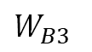
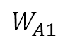
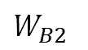
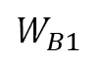
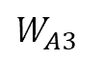
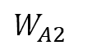
Experiment setup: scenario 1
$$W_{A1}$$
$$W_{A2}$$
$$W_{A3}$$
All materials
except APEC
Input A
Output A
Base A
$$W_{B1}$$
$$W_{B2}$$
$$W_{B3}$$
APEC dataset
Input B
Output B
Base B
1
[YCB+14]
16
Notes:
A five-layer neural network is trained on A and another on B. These networks, which are called Base A and Base B, are shown in the top two rows of Figure 9.1. The labelled rectangles (e.g. $W_{A1}$) represent the weight vector learned for that layer, with the colour indicating which dataset the layer was originally trained on. The vertical bars between weight vectors represent the activations of the network at each layer. A layer n is chosen to train several new networks. In the following explanation and in Figure 9.1, layer $n = 2$ is used as the example layer chosen. The following two networks are defined and trained:
A self transfer network B2B: The first 2 layers are copied from Base B and frozen. The next layers are initialised randomly and trained on dataset B. This network is a control for the next transfer network.
A transfer learning network A2B: The first 2 layers are copied from Base A and frozen. The next layers are initialised randomly and trained toward dataset B. Intuitively, here the first 2 layers are copied from a network trained on dataset A and then learn higher layer features on top of them to predict on a new target dataset B. If A2B performs as well as Base B, there is evidence that the second-layer features are general, at least with respect to B. If performance suffers, there is evidence that the second-layer features are specific to A [YCB+14].

Slide 34
Experiment setup: scenario 1
$$W_{A1}$$
$$W_{A2}$$
$$W_{A3}$$
All materials
except APEC
Input A
Output A
Base A
$$W_{B1}$$
$$W_{B2}$$
$$W_{B3}$$
APEC dataset
Input B
Output B
Base B
1
Weight vector
Layer
[YCB+14]
16
Notes:
A five-layer neural network is trained on A and another on B. These networks, which are called Base A and Base B, are shown in the top two rows of Figure 9.1. The labelled rectangles (e.g. $W_{A1}$) represent the weight vector learned for that layer, with the colour indicating which dataset the layer was originally trained on. The vertical bars between weight vectors represent the activations of the network at each layer. A layer n is chosen to train several new networks. In the following explanation and in Figure 9.1, layer $n = 2$ is used as the example layer chosen. The following two networks are defined and trained:
A self transfer network B2B: The first 2 layers are copied from Base B and frozen. The next layers are initialised randomly and trained on dataset B. This network is a control for the next transfer network.
A transfer learning network A2B: The first 2 layers are copied from Base A and frozen. The next layers are initialised randomly and trained toward dataset B. Intuitively, here the first 2 layers are copied from a network trained on dataset A and then learn higher layer features on top of them to predict on a new target dataset B. If A2B performs as well as Base B, there is evidence that the second-layer features are general, at least with respect to B. If performance suffers, there is evidence that the second-layer features are specific to A [YCB+14].

Slide 35
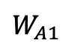
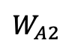
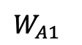
Experiment setup: scenario 2
$$W_{A1}$$
$$W_{A2}$$
$$W_{A3}$$
All materials
except APEC
Input A
Output A
Base A
$$W_{A1}$$
$$W_{A2}$$
APEC dataset
Input B
Output B
Transfer learning
frozen weights
2
To simplify the model, we don’t consider ensemble learning
but mainly focus on transfer learning, namely DNN-TL model
[YCB+14]
17
Notes:
A five-layer neural network is trained on A and another on B. These networks, which are called Base A and Base B, are shown in the top two rows of Figure 9.1. The labelled rectangles (e.g. $W_{A1}$) represent the weight vector learned for that layer, with the colour indicating which dataset the layer was originally trained on. The vertical bars between weight vectors represent the activations of the network at each layer. A layer n is chosen to train several new networks. In the following explanation and in Figure 9.1, layer $n = 2$ is used as the example layer chosen. The following two networks are defined and trained:
A self transfer network B2B: The first 2 layers are copied from Base B and frozen. The next layers are initialised randomly and trained on dataset B. This network is a control for the next transfer network.
A transfer learning network A2B: The first 2 layers are copied from Base A and frozen. The next layers are initialised randomly and trained toward dataset B. Intuitively, here the first 2 layers are copied from a network trained on dataset A and then learn higher layer features on top of them to predict on a new target dataset B. If A2B performs as well as Base B, there is evidence that the second-layer features are general, at least with respect to B. If performance suffers, there is evidence that the second-layer features are specific to A [YCB+14].

Slide 36
Experiment setup: scenario 2
$$W_{A1}$$
$$W_{A2}$$
$$W_{A3}$$
All materials
except APEC
Input A
Output A
Base A
$$W_{A1}$$
$$W_{A2}$$
APEC dataset
Input B
Output B
Transfer learning
frozen weights
2
Random initialised
[YCB+14]
17
Notes:
A five-layer neural network is trained on A and another on B. These networks, which are called Base A and Base B, are shown in the top two rows of Figure 9.1. The labelled rectangles (e.g. $W_{A1}$) represent the weight vector learned for that layer, with the colour indicating which dataset the layer was originally trained on. The vertical bars between weight vectors represent the activations of the network at each layer. A layer n is chosen to train several new networks. In the following explanation and in Figure 9.1, layer $n = 2$ is used as the example layer chosen. The following two networks are defined and trained:
A self transfer network B2B: The first 2 layers are copied from Base B and frozen. The next layers are initialised randomly and trained on dataset B. This network is a control for the next transfer network.
A transfer learning network A2B: The first 2 layers are copied from Base A and frozen. The next layers are initialised randomly and trained toward dataset B. Intuitively, here the first 2 layers are copied from a network trained on dataset A and then learn higher layer features on top of them to predict on a new target dataset B. If A2B performs as well as Base B, there is evidence that the second-layer features are general, at least with respect to B. If performance suffers, there is evidence that the second-layer features are specific to A [YCB+14].

Slide 37
Experiment setup: scenario 2
$$W_{A1}$$
$$W_{A2}$$
$$W_{A3}$$
All materials
except APEC
Input A
Output A
Base A
$$W_{A1}$$
$$W_{A2}$$
APEC dataset
Input B
Output B
Transfer learning
frozen weights
2
Two layers are copied from Base A
Locked: weights are not trainable
[YCB+14]
17
Notes:
A five-layer neural network is trained on A and another on B. These networks, which are called Base A and Base B, are shown in the top two rows of Figure 9.1. The labelled rectangles (e.g. $W_{A1}$) represent the weight vector learned for that layer, with the colour indicating which dataset the layer was originally trained on. The vertical bars between weight vectors represent the activations of the network at each layer. A layer n is chosen to train several new networks. In the following explanation and in Figure 9.1, layer $n = 2$ is used as the example layer chosen. The following two networks are defined and trained:
A self transfer network B2B: The first 2 layers are copied from Base B and frozen. The next layers are initialised randomly and trained on dataset B. This network is a control for the next transfer network.
A transfer learning network A2B: The first 2 layers are copied from Base A and frozen. The next layers are initialised randomly and trained toward dataset B. Intuitively, here the first 2 layers are copied from a network trained on dataset A and then learn higher layer features on top of them to predict on a new target dataset B. If A2B performs as well as Base B, there is evidence that the second-layer features are general, at least with respect to B. If performance suffers, there is evidence that the second-layer features are specific to A [YCB+14].

Slide 38
Experiment setup: scenario 3
$$W_{A1}$$
$$W_{A2}$$
$$W_{A3}$$
All materials
except APEC
Input A
Output A
Base A
$$W_{A1}$$
$$W_{A2}$$
APEC dataset
Input B
Output B
Transfer learning
fine tuning
3
[YCB+14]
18
Notes:
A five-layer neural network is trained on A and another on B. These networks, which are called Base A and Base B, are shown in the top two rows of Figure 9.1. The labelled rectangles (e.g. $W_{A1}$) represent the weight vector learned for that layer, with the colour indicating which dataset the layer was originally trained on. The vertical bars between weight vectors represent the activations of the network at each layer. A layer n is chosen to train several new networks. In the following explanation and in Figure 9.1, layer $n = 2$ is used as the example layer chosen. The following two networks are defined and trained:
A self transfer network B2B: The first 2 layers are copied from Base B and frozen. The next layers are initialised randomly and trained on dataset B. This network is a control for the next transfer network.
A transfer learning network A2B: The first 2 layers are copied from Base A and frozen. The next layers are initialised randomly and trained toward dataset B. Intuitively, here the first 2 layers are copied from a network trained on dataset A and then learn higher layer features on top of them to predict on a new target dataset B. If A2B performs as well as Base B, there is evidence that the second-layer features are general, at least with respect to B. If performance suffers, there is evidence that the second-layer features are specific to A [YCB+14].

Slide 39
Experiment setup: scenario 3
$$W_{A1}$$
$$W_{A2}$$
$$W_{A3}$$
All materials
except APEC
Input A
Output A
Base A
$$W_{A1}$$
$$W_{A2}$$
APEC dataset
Input B
Output B
Transfer learning
fine tuning
3
Two layers are copied from Base A
Unlocked: weights are trainable
[YCB+14]
18
Notes:
A five-layer neural network is trained on A and another on B. These networks, which are called Base A and Base B, are shown in the top two rows of Figure 9.1. The labelled rectangles (e.g. $W_{A1}$) represent the weight vector learned for that layer, with the colour indicating which dataset the layer was originally trained on. The vertical bars between weight vectors represent the activations of the network at each layer. A layer n is chosen to train several new networks. In the following explanation and in Figure 9.1, layer $n = 2$ is used as the example layer chosen. The following two networks are defined and trained:
A self transfer network B2B: The first 2 layers are copied from Base B and frozen. The next layers are initialised randomly and trained on dataset B. This network is a control for the next transfer network.
A transfer learning network A2B: The first 2 layers are copied from Base A and frozen. The next layers are initialised randomly and trained toward dataset B. Intuitively, here the first 2 layers are copied from a network trained on dataset A and then learn higher layer features on top of them to predict on a new target dataset B. If A2B performs as well as Base B, there is evidence that the second-layer features are general, at least with respect to B. If performance suffers, there is evidence that the second-layer features are specific to A [YCB+14].

Slide 40
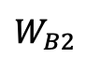
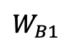
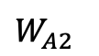
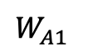
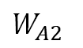
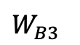
Experiment setup overview
$$W_{A1}$$
$$W_{A2}$$
$$W_{A3}$$
All materials
except APEC
Input A
Output A
Base A
$$W_{B1}$$
$$W_{B2}$$
$$W_{B3}$$
APEC dataset
Input B
Output B
Base B
1
$$W_{A1}$$
$$W_{A2}$$
APEC dataset
Input B
Output B
2
Transfer learning
frozen weights
$$W_{A1}$$
$$W_{A2}$$
APEC dataset
Input B
Output B
Transfer learning
fine tuning
3
[YCB+14]
19
Notes:
A five-layer neural network is trained on A and another on B. These networks, which are called Base A and Base B, are shown in the top two rows of Figure 9.1. The labelled rectangles (e.g. $W_{A1}$) represent the weight vector learned for that layer, with the colour indicating which dataset the layer was originally trained on. The vertical bars between weight vectors represent the activations of the network at each layer. A layer n is chosen to train several new networks. In the following explanation and in Figure 9.1, layer $n = 2$ is used as the example layer chosen. The following two networks are defined and trained:
A self transfer network B2B: The first 2 layers are copied from Base B and frozen. The next layers are initialised randomly and trained on dataset B. This network is a control for the next transfer network.
A transfer learning network A2B: The first 2 layers are copied from Base A and frozen. The next layers are initialised randomly and trained toward dataset B. Intuitively, here the first 2 layers are copied from a network trained on dataset A and then learn higher layer features on top of them to predict on a new target dataset B. If A2B performs as well as Base B, there is evidence that the second-layer features are general, at least with respect to B. If performance suffers, there is evidence that the second-layer features are specific to A [YCB+14].

Slide 41
Effect of the training dataset size on transfer learning
20
Notes:
The results of this comparison and the effect of the training dataset size on R² value are illustrated in Figure 9.4. ‘%’ in the sub-caption denotes availability of target domain data.
Firstly, it can be observed that the performance improvement of DNN-TL over DNN is attributed to employing transfer learning.

Slide 42
Effect of the training dataset size on transfer learning
1001 samples for the total APEC training dataset
20
Notes:
The results of this comparison and the effect of the training dataset size on R² value are illustrated in Figure 9.4. ‘%’ in the sub-caption denotes availability of target domain data.
Firstly, it can be observed that the performance improvement of DNN-TL over DNN is attributed to employing transfer learning.

Slide 43
Effect of the training dataset size on transfer learning
20
Notes:
The results of this comparison and the effect of the training dataset size on R² value are illustrated in Figure 9.4. ‘%’ in the sub-caption denotes availability of target domain data.
Firstly, it can be observed that the performance improvement of DNN-TL over DNN is attributed to employing transfer learning.

Slide 44
Effect of the training dataset size on transfer learning
20
Notes:
The results of this comparison and the effect of the training dataset size on R² value are illustrated in Figure 9.4. ‘%’ in the sub-caption denotes availability of target domain data.
Firstly, it can be observed that the performance improvement of DNN-TL over DNN is attributed to employing transfer learning.

Slide 45
Effect of the training dataset size on transfer learning
20
Notes:
The results of this comparison and the effect of the training dataset size on R² value are illustrated in Figure 9.4. ‘%’ in the sub-caption denotes availability of target domain data.
Firstly, it can be observed that the performance improvement of DNN-TL over DNN is attributed to employing transfer learning.

Slide 46
Effect of the training dataset size on transfer learning
Transfer learning with fine tuning can achieve good performance based on very small dataset
20
Notes:
The results of this comparison and the effect of the training dataset size on R² value are illustrated in Figure 9.4. ‘%’ in the sub-caption denotes availability of target domain data.
Firstly, it can be observed that the performance improvement of DNN-TL over DNN is attributed to employing transfer learning.

Slide 47
Effect of the training dataset size on transfer learning
Under similar performance,
transfer learning needs less data
20
Notes:
The results of this comparison and the effect of the training dataset size on R² value are illustrated in Figure 9.4. ‘%’ in the sub-caption denotes availability of target domain data.
Firstly, it can be observed that the performance improvement of DNN-TL over DNN is attributed to employing transfer learning.

Slide 48
Effect of the training dataset size on transfer learning
Significant improvement
20
Notes:
The results of this comparison and the effect of the training dataset size on R² value are illustrated in Figure 9.4. ‘%’ in the sub-caption denotes availability of target domain data.
Firstly, it can be observed that the performance improvement of DNN-TL over DNN is attributed to employing transfer learning.

Slide 49

Improvement percentage of R² value due to transfer learning
21
Notes:
The performance improvement becomes apparent as the training dataset size decreases, suggesting that transfer learning is a useful tool for enhancing the quality estimation performance, especially when the training dataset is small. As the size of the training dataset increases, the performance improvement results from employing transfer learning gradually decreased. This is because it is difficult to find parameters that can simultaneously fit the source and target tasks very well.

Slide 50
Improvement percentage of R² value due to transfer learning
Average improvement of 9.36 %
21
Notes:
The performance improvement becomes apparent as the training dataset size decreases, suggesting that transfer learning is a useful tool for enhancing the quality estimation performance, especially when the training dataset is small. As the size of the training dataset increases, the performance improvement results from employing transfer learning gradually decreased. This is because it is difficult to find parameters that can simultaneously fit the source and target tasks very well.

Slide 51
Outline
Motivation of applying transfer learning
Dataset description and feature ranking
Construction of DNN-ETL model
Transfer learning performance analysis
Application scenario of DNN-ETL
Conclusion and outlook
[URL00]
22

Slide 52

Application in finding best machine settings
Quality feedback
Machine settings
Product quality
e.g. target weight
Machine operator
Trial of machine settings based on:
▪ Recommendations of material supplier
▪ Experience, intuition of the operator
[Hei17]
23
Notes:
The process towards an optimised machine parameter setting is recognized as one of the most important steps in injection moulding for improving the quality of moulded products [SWL07]. Since the quality of injection moulded plastic parts can be influenced by process conditions, how to determine the optimal machine setting parameters for different materials becomes the key to improving the part quality.

Slide 53
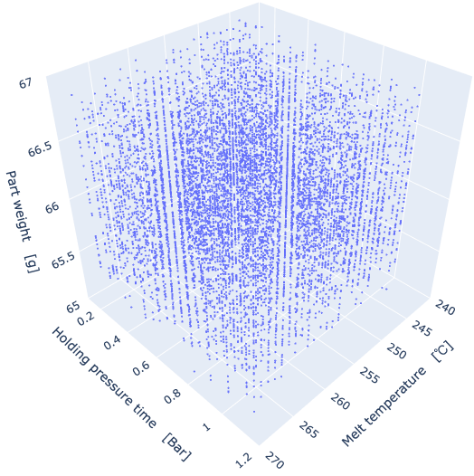
Part weight prediction of random machine settings combination
Blue points are output samples
Material properties
Machine settings
…
SABIC
VALOX
ULTEM
…
APEC
APEC
APEC
Fine tuned DNN
Fine tuned DNN
…
Fine tuned DNN
Mean prediction
Quality value
Proposed DNN-ETL model
Prediction result of 10000 samples
25

Slide 54
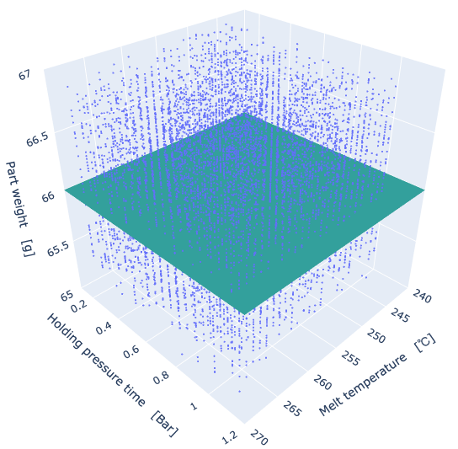
Output of process condition recommender system
Satisfactory points
(10 samples)
Example experiment
Current machine setting parameters
No. | Melt temp. | Cavity temp. | Press time | Cool time | Flow rate | Hold press
1 | 245 | 48 | 1 | 1.5 | 43 | 490
Target weight
26
Notes:
Calculate distance from current state

Slide 55
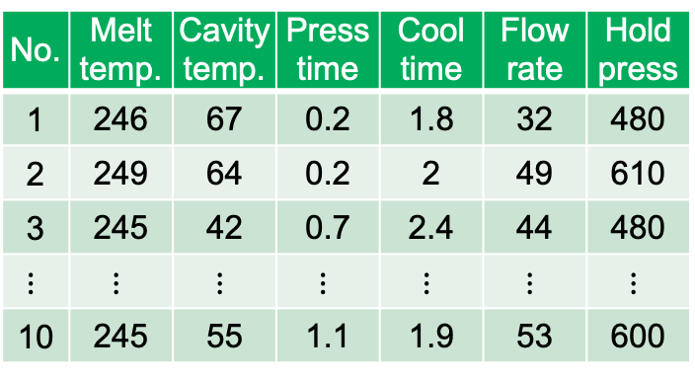
Output of process condition recommender system
Satisfactory points
(10 samples)
Example experiment
Current machine setting parameters
No. | Melt temp. | Cavity temp. | Press time | Cool time | Flow rate | Hold press
1 | 245 | 48 | 1 | 1.5 | 43 | 490
Calculate distance
Target weight
Final recommend conditions
No. | Melt temp. | Cavity temp. | Press time | Cool time | Flow rate | Hold press
1 | 246 | 67 | 0.2 | 1.8 | 32 | 480
2 | 249 | 64 | 0.2 | 2 | 49 | 610
3 | 245 | 42 | 0.7 | 2.4 | 44 | 480
$$⋮$$ | $$⋮$$ | $$⋮$$ | $$⋮$$ | $$⋮$$ | $$⋮$$ | $$⋮$$
10 | 245 | 55 | 1.1 | 1.9 | 53 | 600
Evaluation fuction
26
Notes:
Calculate distance from current state

Slide 56
Outline
Motivation of applying transfer learning
Dataset description and feature ranking
Construction of DNN-ETL model
Transfer learning performance analysis
Application scenario of DNN-ETL
Conclusion and outlook
[URL00]
27

Slide 57
Conclusion and outlook
Develop DNN-ETL model
R² test score is 0.9207 and it surpasses the state-of-the-art performance of 0.90 [TGH+18]
Analyse the improvement due to transfer learning
An average improvement of 9.36 % of R² value can be achieved compared to DNN without transfer learning.
Apply feature ranking method
Five most important features: solid density, holding pressure, thermal conductivity, no flow temperature and ejection temperature
28

Slide 58
Conclusion and outlook
Develop DNN-ETL model
R² test score is 0.9207 and it surpasses the state-of-the-art performance of 0.90 [TGH+18]
Analyse the improvement due to transfer learning
An average improvement of 9.36 % of R² value can be achieved compared to DNN without transfer learning.
Apply feature ranking method
Five most important features: solid density, holding pressure, thermal conductivity, no flow temperature and ejection temperature
“when to transfer”
“what to transfer”
Two datasets with same feature space
28

Slide 59
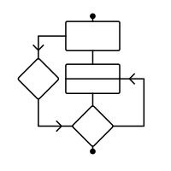
Conclusion and outlook
Develop DNN-ETL model
R² test score is 0.9207 and it surpasses the state-of-the-art performance of 0.90 [TGH+18]
Analyse the improvement due to transfer learning
An average improvement of 9.36 % of R² value can be achieved compared to DNN without transfer learning.
Apply feature ranking method
Five most important features: solid density, holding pressure, thermal conductivity, no flow temperature and ejection temperature
Two datasets with same feature space
Test whether the marginal distributions
of two domains are similar
Algorithms
28

Slide 60
I am happy to answer your questions.
Weibo Zhao Telefon: +49 1637640827 E-Mail: weibo.zhao@rwth-aachen.de
29

Slide 61
References
[Hei17]: Heinisch, J.: From simulation to injection moulding machine - Optimized process setup based on machine learning citation. International Mold Conference Bucheon, 2017
[OBL14]: OQUAB, M.; BOTTOU, L.; LAPTEV, I.; SIVIC, J.: Learning and transferring mid-level image representations using convolutional neural networks. Proceedings of the IEEE conference on computer vision and pattern recognition, 1717-1724, 2014
[TGH+18]: TERCAN, H.; GUAJARDO, A.; HEINISCH, J.; THIELE, T., HOPMANN, C.; MEISEN, T.: Transfer-Learning: Bridging the Gap Between Real and Simulation Data for Machine Learning in Injection Moulding, Proc. CIRP,72, 185–190, 2018
[TS09]: TORREY, L.; SHAVLIK, J.: Transfer Learning. Handbook of Research on Machine Learning Applications. IGI Global, 2009
[URL00]: N.N.: Injection moulding machine, https://www.seasongroup.com/manufacturing-services/plastic-injection-molding/
[URL01]: N.N.: PLEXIGLAS Zuschnitt nach Maß. URL: https://kunststoffplattenonline.de/plexiglas/, 24.09.2020
[YCB+14]: YOSINSKI, J.; CLUNE, J.; BENGIO, Y.; LIPSON, H.: How transferable are features in deep neural networks? Conference of Advances in Neural Information Processing Systems. 3320-3328, 2014
30

Slide 62
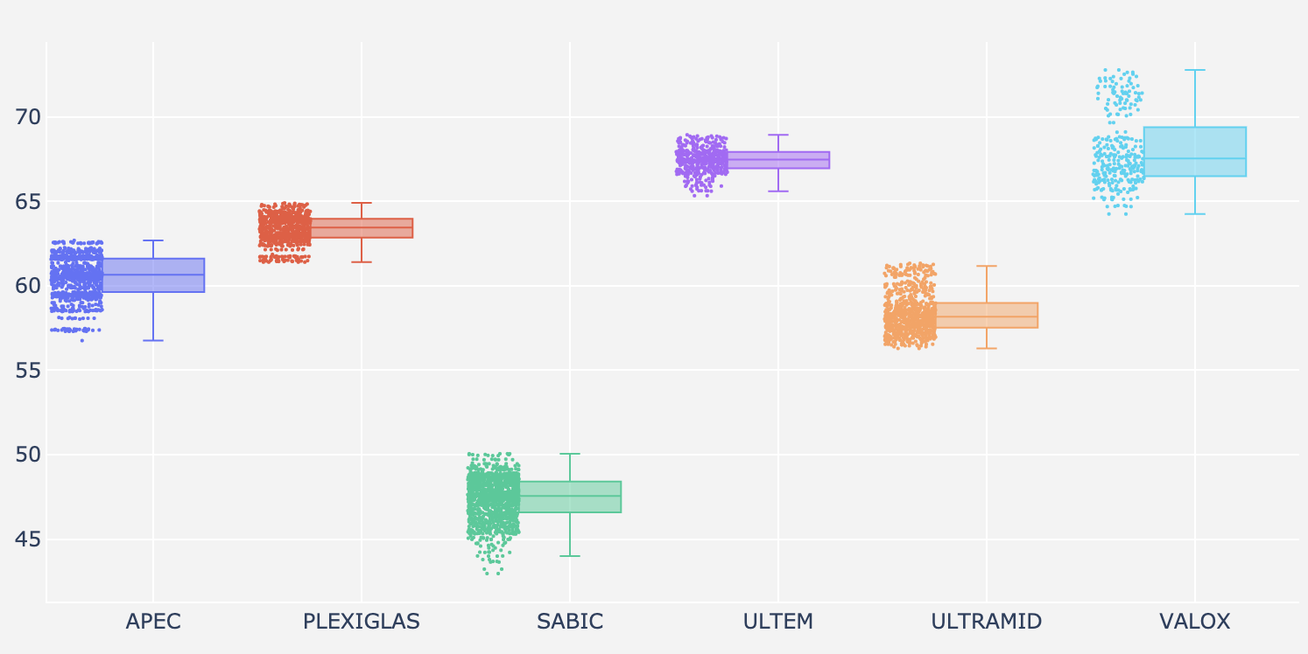
Data visualization of the part weight of the six material classes
Part weight [g]
Material class [-]
Figure 7.3
Notes:
The 60 materials can be divided to six product classes, namely APEC, PLEXIGLAS, SABIC PP, ULTEM, ULTRAMID and VALOX. Figure 7.3 shows that the quality values like part weight within a same material class have similar range compared to other material classes. Each point represents a simulation result of one material under certain machine setting conditions. The part weight of the toy building block is influenced by the class of materials.

Slide 63

Different part weight distribution of six material classes
APEC
PLEXIGLAS
SABIC PP
ULTEM
ULTRAMID
VALOX
Cadmould simulations data
Use different dataset
45 50 55 60 65 70 75
23
Notes:
The quality values of different material classes have different data distributions, shown in Figure 9.5. This justifies the need for multi-source transfer learning, where knowledge is transferred from each source database to the DNN-TL model. In the whole source dataset, each material class represents a source with its own distribution. It is interesting to investigate how the number of source data with different distributions affect the performance of DNN-TL on target task.

Slide 64
Qualitative depiction of 2^{n}-Experiment (n=3) plan including star and center point
77 times of Machine settings combination
Central composite design
(CCD) of experiments:
Full-factorial experimental design (64-point cube) 2⁶
Star points outside the cube (12 points)
Central point
×Step value
2 ×Step value
Figure 7.2

Slide 65

Feature ranking by ensemble learning method
Same dataset
Machine settings and material properties
放在后面，如果有人问在拿出来
Regression models/
Feature ranking methods
可以用在both Predictions/
Feature importance
Decision
Tree
Random
Forest
Gradient
Boost
Ada
boost
Extra
Tree
XGBoost
Predictions/
Feature importance score
1
2
3
4
5
6
Ensemble regressor
Ensemble’s prediction
Mean value
8
Notes:
Feature ranking algorithms rank the features in accordance with their predictive scores. Six feature ranking techniques are applied, namely XGBoost [MHK20], Extra Tree [GEW06], Decision Tree [Loh11], Gradient Boosting [HTF09], Ada Boost [TLX17] and Random Forest [Bre01]. For each method, the features are ranked with the calculated feature importance score, the sum of which is equal to one. Due to different principle of algorithms, the feature ranking results of six methods differ from each other. One plausible solution is to use the ensemble learning idea to calculate the summation or mean importance score of each feature.

Slide 66
Splitting source dataset into 5 folds according to material classes
Total dataset
PLEXIGLAS | SABIC | ULTEM | ULTRAMID | VALOX | APEC
Source task
Target task
Pre-trained DNN 1
PLEXIGLAS | SABIC | ULTEM | ULTRAMID | VALOX
APEC
Pre-trained DNN 2
PLEXIGLAS | SABIC | ULTEM | ULTRAMID | VALOX
Pre-trained DNN 3
PLEXIGLAS | SABIC | ULTEM | ULTRAMID | VALOX
Pre-trained DNN 4
PLEXIGLAS | SABIC | ULTEM | ULTRAMID | VALOX
Pre-trained DNN 5
PLEXIGLAS | SABIC | ULTEM | ULTRAMID | VALOX
13
Notes:
As illustrated in Figure 8.4, the APEC dataset is selected as target task, while the whole dataset of the rest material classes is the source task. In pre-training, the source dataset was first split into 5 folds according to the material classes. Subsequently, a fold of the data (indicated by the green block) is held out to pre-train a DNN model. As a result, 5 pre-trained DNN models are trained using the source dataset, each associated with one material.

Slide 67
Possible advantages due to transfer learning
Coefficient of determination
The higher, the better performance
R2 value
[TS09]
4
Notes:
From literature, there a three possible advantages due to transfer learning. The metric we use to evaluate the performance of the model is R2. The higher the value, the better the model performance. We compare the R2 value under different amount of training set. The green curve is the model with transfer learning while the black curve without transfer learing. It can be found that the green curve has higher start, higher slope and higher asymptote, which means transfer learning has better performance.

Slide 68
Possible advantages due to transfer learning
3
Higher asymptote
R2 value
2
Higher slope
1
Higher start
[TS09]
4
Notes:
From literature, there a three possible advantages due to transfer learning. The metric we use to evaluate the performance of the model is R2. The higher the value, the better the model performance. We compare the R2 value under different amount of training set. The green curve is the model with transfer learning while the black curve without transfer learing. It can be found that the green curve has higher start, higher slope and higher asymptote, which means transfer learning has better performance.

Slide 69
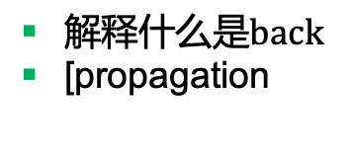
Difference of frozen weights and fine tuning
Forward direction
$$W_{A1}$$
$$W_{A2}$$
$$W_{A3}$$
All material
except APEC
Input A
Output A
$解释什么是back$
[propagation
Transferred layer n
Back propagation
AnB: Frozen weights
$$W_{A1}$$
APEC dataset
Input B
Output B
Back propagation
AnB+: Fine tuning
19
Notes:
This process is repeated for all n. In the above two networks, the transferred layers are frozen. There are two versions of the above two networks where the transferred layers are fine-tuned:
A self transfer network B2B+: just like B2B, but where all layers learn.
A transfer network A2B+: just like A2B, but where all layers learn.
Figure 9.2 depicts the difference between frozen weights and fine tuning.

Slide 70
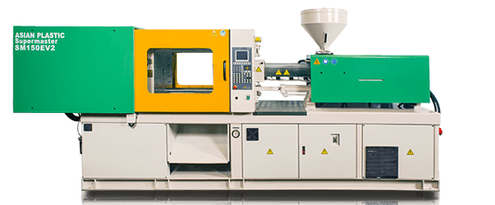
Generation of input features
Melt temperature
245 Step 1 270
Cavity wall temperature
40 Step 1 100
Holding pressure time
Material properties
extracted from mould
0.2 Step 0.1 1.2
+
Cooling time
1.5 Step 0.1 2.5
Injection flow rate
30 Step 1 55
Machine settings
Holding pressure
400 Step 10 912
10000 samples with random machine settings
24
Notes:
The process towards an optimised machine parameter setting is recognized as one of the most important steps in injection moulding for improving the quality of moulded products [SWL07]. Since the quality of injection moulded plastic parts can be influenced by process conditions, how to determine the optimal machine setting parameters for different materials becomes the key to improving the part quality.

Slide 71
Thesis figures

Slide 72
Mögliche Vorteile durch Transferlernen
3
Höhere Asymptote
2
Höhere Steigung
ohne Transferlernen
1
Höherer Start
mit Transferlernen
[TS09]
Abbildung 2.1

Slide 73
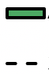

Verbesserung des R2-Werts durch Transferlernen bei Vorhandensein weniger Daten der APEC-Materialdomäne
﻿Durchschnittliche Verbesserung
Abbildung 2.2

Slide 74
Possible advantages due to transfer learning
3
Higher asymptote
2
Higher slope
1
Higher start
[TS09]
Figure 2.1

Slide 75
Improvement of the R² value by transfer learning in presence of few data from the APEC material domain
Figure 2.2

Slide 76
Research methodology approach
Simulation
Data mining
Raw dataset
Data visualization
Preprocessing
Model construction
Feature ranking
Deep learning
Transfer learning
Ensemble learning
Traditional machine learning
Comparison
Weight frozen / fine tuning
Training data size
Number of transferred layers
Single or multisource transfer
Single task and multitask learning
Figure 3.1

Slide 77
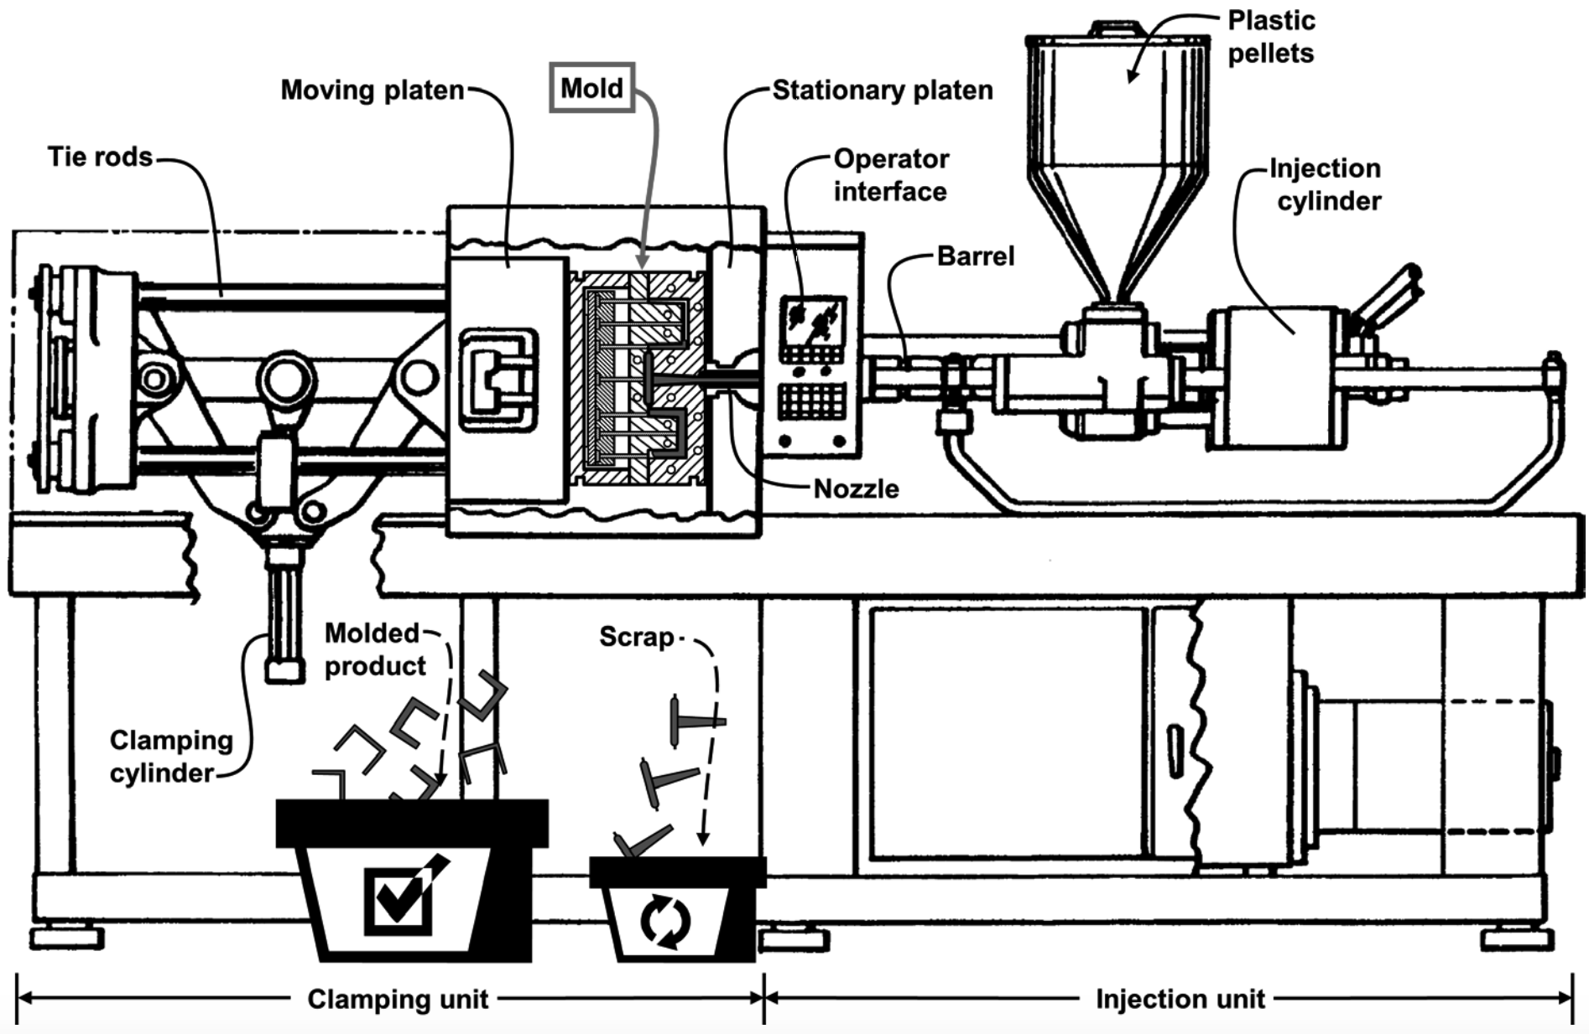
Depiction of an injection moulding machine
[Kra05]
Figure 4.1
Notes:
Schematics of the IM machine can be seen in figure
Kramschuster, A., et al., Quantitative study of shrinkage and warpage behavior for microcellular and conventional injection molding, Polym. Eng. Sci., (2005) 45(10): pp. 1408–1418

Slide 78
Influence factors of product quality in injection moulding
Part design
Man
Environment
Tolerance ____
Symmetry_???
Ribs design_?_
Reinforcement__
Wall dimensions_
_____
Training_???
Experience_?_
Supervision__
Air currents____
Relative humidity ???
Ambient temperature_?_
Cooling water temp.__
Interface conditions _
Product quality
Cooling channel
Venting holes_
Flow design__
Injection type___
Runner____
Gates_____
Specific heat constant
Thermal conductivity_
Thermal diffusivity__
Solid density___
Melt density____
E constant_____
Holding pressure time
Cavity wall temperature_
Melt temperature__
Holding pressure___
Injection flow rate____
Cooling time_____
Mold design
Material
Machine setting
[STT+08]
Figure 4.2
Notes:
Injection moulding is a complex process, from design, fabrication, assembly, testing, and finally being put into use. Throughout the life cycle, there are many factors affecting injection moulding quality from all kind of aspects of raw material properties, mould design, injection moulding machine setting and so on. A better control of these influence factors allows for a better final quality of the injection moulding products.

Slide 79
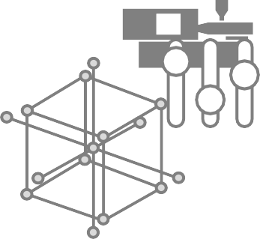
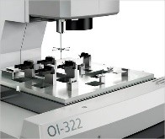
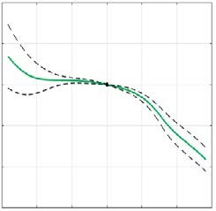
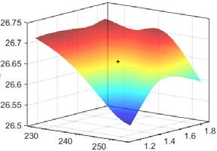
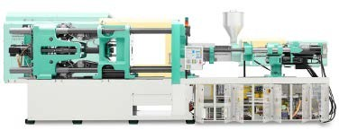

Process setup by means of machine learning
Design of experiments
Injection moulding simulation
Model construction
Optimisation
Figure 4.3

Slide 80
A practical view of a machine learning system
Training
set
Model training
Training
Raw data
Feature
engineering
Validation
set
Model selection
Machine
learning
Evaluation
Test
set
Model
Predicting
New data
Feature
engineering
Prediction
Target
[Osm19]
Figure 5.1
Notes:
https://techblog.cdiscount.com/assets/images/DataScience/automl/ML_process.png[Osm19]

Slide 81
Methods of machine learning
Machine
learning
Supervised
learning
Unsupervised
learning
Classification Regression Clustering
▪ Logistic
regressions
▪ Support Vector Machines
▪ Random forest
▪ Extra tree
▪ Decision tree
▪ Deep neural networks
▪ Connectivity- based clustering
▪ Distribution- based clustering
[Mit97]
Figure 5.2

Slide 82
Model performance influenced by number of training epohcs
Underfitting
Error
Generalization error
Early stopping
Just right
Overfitting
Training error
Number of training epochs
[GBC16]
Figure 5.3

Slide 83

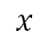
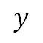
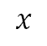
Comparison of underfitting, appropriate fitting and overfitting
$$y$$
$$x$$
$$x$$
$$x$$
Underfitting
(Too simple to explain the variance)
Appropriate fitting
(Good Generalization)
Overfitting
(Too good to be true)
[FW95]
Figure 5.4

Slide 84
Cross validation
Cross validation
Total dataset
Testing data
Training data
Split 1
Fold 1 | Fold 2 | Fold 3 | Fold 4 | Fold 5
Split 2
Fold 1 | Fold 2 | Fold 3 | Fold 4 | Fold 5
Split 3
Fold 1 | Fold 2 | Fold 3 | Fold 4 | Fold 5
Split 4
Fold 1 | Fold 2 | Fold 3 | Fold 4 | Fold 5
Split 5
Fold 1 | Fold 2 | Fold 3 | Fold 4 | Fold 5
[JH15]
Figure 5.5
Notes:
Procedure of five-fold cross validation (CV). The training set in each CV trial consisted of 80% of all samples randomly drawn from the dataset representing 16 cells, while the remaining 20% of the samples were used to form the validation set.

Slide 85
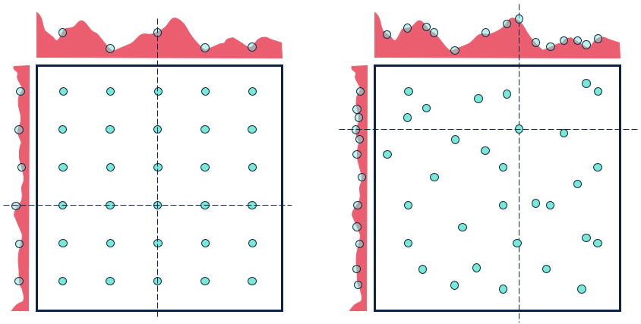
Hyperparameter tuning
Grid search
Random search
[BB12]
Figure 5.6

Slide 86
Different concepts of single task learning and multitask learning
Single task learning
Training data
Training
Trained model
Task 1
Prediction 1
Training data
Training
Trained model
Task 2
Prediction 2
…
…
Training data
Training
Trained model
Task k
Prediction k
Multitask learning
Task 1
Training data
Prediction 1
Task 2
Training data
Joint training
with shared
representation
Trained model
Prediction 2
…
Task k
Training data
Prediction k
[Car93]
Figure 5.7
Notes:
Difference between multitask learning and traditional single task learning. In MTL the learning process involves all the tasks and is performed jointly, allowing the exchange of information.

Slide 87
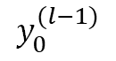
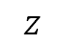
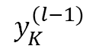











One perceptron of the layer $l$
Perceptron $j$
$$Σ$$
$$z$$
$$σ(z)$$
$$y_{0}^{(l−1)}$$
$$w_{j,0}^{(l)}$$
$$y_{1}^{(l−1)}$$
$$w_{j,1}^{(l)}$$
$$w_{j,2}^{(l)}$$
$$j$$
$$y_{2}^{(l−1)}$$
$$y_{j}^{(l)}$$
$$w_{j,K}^{(l)}$$
…
$$y_{K}^{(l−1)}$$
[JZL18]
Figure 5.8
Notes:
The circle describes the perceptron, in which is applied the linear combination and the activation function.

Slide 88
Stucture of deep neural network (DNN)
Hidden layer 1
Input layer
Hidden layer 2
Output layer
Input data
Output result
[Saz06]
Figure 5.9

Slide 89

Difference between momentum update and Nesterov momentum update
Momentum update
Nesterov momentum update
[SMD13]
Figure 5.10

Slide 90
Fundamental approach of transfer learning
Source domain
Source task
Target domain
Knowledge
Transfer
Knowledge
Learning system
Target task
[OBL14]
Figure 6.1

Slide 91
Categorization of transfer learning approaches
Transfer Learning
Labeled data are available in a target domain
Labeled data are available only in a source domain
No labeled data in both source and targt domain
Inductive Transfer Learning
Transductive Transfer Learning
Unsupervised Transfer Learning
Labeled data are available in a source domain
No labeled data in a source domain
Different domains but single task
Single domain and single task
Multi-task Learning
Self-taught Learning
Domain Adaption
Sample Selection Bias/Covariance Shift
[ZLO17]
Figure 6.2

Slide 92
Distinction between transfer learning and multi-task learning
Transfer learning
Multitask learning
Task 1
Task 3
Source task
Target task
Task 2
Task 4
[TS09]
Figure 6.3
Notes:
In transfer learning the information flows in one direction only, from the source task to the target task. In multitask learning, information can flow freely among all tasks

Slide 93
Component dimensions of the 4$×$2 toy building block
Roundness (R_{max}-R_{min})
Height
W°
Length
Angular
Width
Figure 7.1

Slide 94
Qualitative depiction of 2^{n}-Experiment (n=3) plan including star and center point
×Step value
2 ×Step value
Figure 7.2

Slide 95
Data visualization of the part weight of the six material classes
Part weight [g]
Material class [-]
Figure 7.3

Slide 96
Feature importance score ranking for prediction of part weight
Figure 7.4

Slide 97
Structure of the deep neural network with transfer learning
Source task
Target task
Output layer
(5 node)
Hidden layer
(10 node)
 | ……..
 | ……..
Reuse
Hidden layer
(25 node)
 |  | ……..
 |  | ……..
Hidden layer
(50 node)
 |  | ……………………..
 |  | ……………………..
Input layer
(50 node)
 |  | ……………………..
 |  | ……………………..
Figure 8.1

Slide 98
Prediction result of the base model
Figure 8.2

Slide 99
Comparison of single task, multitask and ensemble learning
Figure 8.3

Slide 100
Splitting source task into 5 folds for pre-training DNN models
Total dataset
PLEXIGLAS | SABIC | ULTEM | ULTRAMID | VALOX | APEC
Source task
Target task
Pre-trained DNN 1
PLEXIGLAS | SABIC | ULTEM | ULTRAMID | VALOX
APEC
Pre-trained DNN 2
PLEXIGLAS | SABIC | ULTEM | ULTRAMID | VALOX
Pre-trained DNN 3
PLEXIGLAS | SABIC | ULTEM | ULTRAMID | VALOX
Pre-trained DNN 4
PLEXIGLAS | SABIC | ULTEM | ULTRAMID | VALOX
Pre-trained DNN 5
PLEXIGLAS | SABIC | ULTEM | ULTRAMID | VALOX
Figure 8.4

Slide 101
Model structure of transfer learning with ensemble learning
Input
Material properties
Machine setting parameters
Pre-trained DNN
…
SABIC
VALOX
ULTEM
DNN with
transfer learning
(Target: APEC)
…
APEC
APEC
APEC
Output of DNN-TL
Fine tuned DNN
Fine tuned DNN
…
Fine tuned DNN
Ensemble learning
Mean prediction
Result
Quality value
Figure 8.5

Slide 102
Model comparison of R² value
Algorithms [-]
Figure 8.6

Slide 103


Overview of the experimental treatments and controls
$$W_{A1}$$
$$W_{A2}$$
$$W_{A3}$$
Source task
Input A
Output A
Base A
$$W_{B1}$$
$$W_{B2}$$
$$W_{B3}$$
Target task
Input B
Output B
Base B
$$W_{B1}$$
$$W_{B2}$$
Input B
B2B (Frozen weight)
B2B+ (Fine tuning)
Self Transfer
$$W_{A1}$$
$$W_{A2}$$
Input B
Transfer
Learning
A2B (Frozen weight)
A2B+ (Fine tuning)
Figure 9.1

Slide 104


Difference of AnB and AnB+ transfer learning model
Forward direction
Large dataset
Input A
Task A
Transfer
Layer n
Back propagation
AnB: Frozen weights
Relatively
small dataset
Input B
Task B
Back propagation
AnB+: Fine tuning
Figure 9.2

Slide 105
Effect of the number of transferred layers on transfer learning
Figure 9.3

Slide 106
Effect of the training dataset size on transfer learning
Figure 9.4

Slide 107
Different part weight distribution of six material classes
APEC
PLEXIGLAS
SABIC PP
ULTEM
ULTRAMID
VALOX
45 50 55 60 65 70 75
Figure 9.5

Slide 108
Effect of the number of source datasets on transfer learning
Figure 9.6

